Slide 1
Development of a Multi-functionality Android Application
(Message Encryption + Text To Speech Conversion )

Slide 2
Table of Contents
Motivation and Justification
Android
Problem Definition and Scope
SharedPreferences
Sending an SMS
BroadCastReceiver
Intents
SQLiteDatabase ( Creating a Database )
Conclusion
References

Slide 3
Motivation and Justification
Be safe when you are driving
PRIVACY
SECURITY

Slide 4
Android
Android is a Linux-based operating system for mobile devices and tablets.^{[1]}
Key features:
Open
All applications are created equally
Fast and easy application development^{[1]}

Slide 5
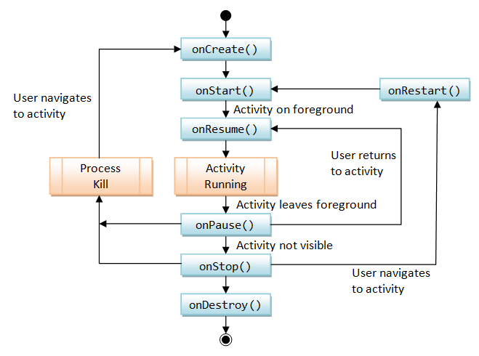
Activity Life Cycle in Android

Slide 6
Problem Definition and Scope
To create an efficient android app that includes multiple functionalities such as text to speech convertor and message encryption. The text to speech convertor comes with the capabilities such as reading only the message body, reading only the caller’s name when we get a call or a sms or both. Also the message encryption comes with capabilities such as sending encoded texts over an SMS , adding encrypted codes and the ability to display the codes already used.
1. Text to Speech Converter: It will speak the Incoming Caller Id or name when the caller name is saved in contact list otherwise it will say UNKNOWN word instead of name. It will speak Message Sender Name and Message body too.
Useful for a Person who is busy in work or while driving.
2. Message Encryption: Sometimes we need to send message to people but there are other people around us and we might feel uncomfortable. So we store important messages in the database with some logic and use the same. The message body code will replace with original data from database which is stored by us.
The application also has a Help and About category explaining how to use it and the usefulness of each of these applications respectively.

Slide 7
SharedPreferences
The class TextToSpeech.java uses SharedPreferences. It has the onCreate method defined.
Android SharedPreferences is useful when you want to save some data across all Activity.
Session are useful when you want to store user data globally through out the application. This can be done in two ways. One is storing them in a global variables and second is storing the data in shared preferences. The problem with storing data in global variable is data will be lost once user closes the application, but storing the data in shared preferences will be persistent even though user closes the application.
Application shared preferences allows you to save and retrieve key, value pair data
In our code of TextToSpeech.java we use SharedPreferences to store Boolean value of the checkboxes for Read Call only, Read Message and Read Sender

Slide 8
Initialization
Application shared preferences can be fetched using getSharedPreferences() method.You also need an editor to edit and save the changes in shared preferences. The following code can be used to get application shared preferences.
Storing Data
You can save data into shared preferences using editor. All the primitive data types like booleans, floats, ints, longs, and strings are supported. Call editor.commit() in order to save changes to shared preferences.^{[2]}

Slide 9
Sending An SMS
SmsManager API
- SmsManager smsManager = SmsManager.getDefault();
- smsManager.sendTextMessage("phoneNo", null, "sms message", null, null);
- To allow the application to send an SMS we need to give the app permissions as well. This is given in the AndroidManifest.xml file as follows:
<uses-permission android:name="android.permission.SEND_SMS" />^{[3]}

Slide 10
BroadCastReceiver
A broadcast receiver (short receiver) is an Android component which allows you to register for system or application events. All registered receivers for an event will be notified by the Android runtime once this event happens.
For example applications can register for the ACTION_BOOT_COMPLETED system event which is fired once the Android system has completed the boot process.^{[4]}

Slide 11
TelephonyManager.CALL_STATE_IDLE
No activity
TelephonyManager.CALL_STATE_RINGING
A new call arrived and is ringing or waiting. In the latter case, another call is already active.
TelephonyManager.CALL_STATE_OFFHOOK
At least one call exists that is dialing, active, or on hold, and no calls are ringing or waiting( Local or International Calls )

Slide 12
Intents
An Intent is an abstract description of an operation to be performed.
Can be used with startActivity to launch an Activity
An Intent object is passed to
Context.startActivity() or Activity.startActivityForResult()
to launch an activity or get an existing activity to do something new.^{[5]}

Slide 13
SQLiteDatabase
In Android the SQLiteDatabase namespace defines the functionality to connect and manage a database.
It provides functionality to create , delete , manage and display database concept.
Arguably the most widely used database engine as it is used today by several widespread browsers , OS and embedded systems among others.
Unlike most other SQL databases, SQLite does not have a separate server process.
SQLite reads and writes directly to ordinary disk files

Slide 14
SQLite is generally a lot faster than SQL Server
SQLite also runs in process and reduces a lot of the overhead that a database brings--all data is cached and queried in-process.
However, SQLite only supports a single writer at a time (meaning the execution of an individual transaction).
SQLite locks the entire database when it needs a lock (either read or write) and only one writer can hold a write lock at a time

Slide 15
Creating A Database
Simple steps to create a database and handle are as following.
Create "SQLiteDatabase" object.
Open or Create database and create connection.
Perform insert, update or delete operation.
Create Cursor to display data from table of database.
Close the database connectivity.^{[6]}

Slide 16
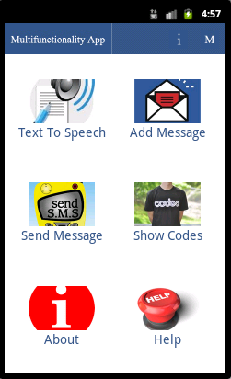
Screenshot

Slide 17
Conclusion
Hence an android application was made that can do both TextToSpeech Conversion as well as encrypt Messages. We can also view the current codes in our database as well as Update or Delete the messages in the database.

Slide 18
References
[1] WEB URL “http://developer.android.com/about/index.html”
[2] WEB URL “http://developer.android.com/reference/android/content/SharedPreferences.html”
[3]WEB URL “http://developer.android.com/reference/android/content/BroadcastReceiver.html”
[4] WEB URL
“http://developer.android.com/reference/android/telephony/gsm/SmsManager.html”
[5]WEB URL “http://developer.android.com/reference/android/content/Intent.html”
[6] WEB URL “http://developer.android.com/reference/android/database/sqlite/package-summary.html”

